Slide 1

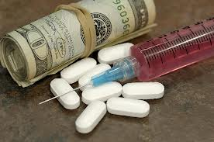
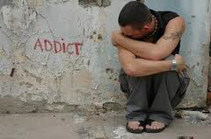
Levels of Addiciton

Slide 2
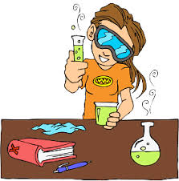
EXPERIMENTATION
-curiosity is the motivator
-learning about mood swings from drug
-learning to trust/mistrust the drug
-”high” is a new feeling
-can still relate to people

Slide 3
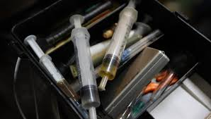
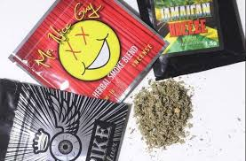
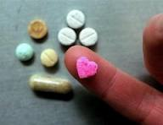
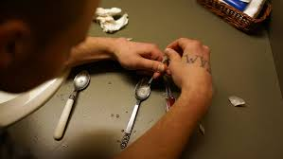
REGULAR USE
-decision to use has been made
-seeks “high”
-comfort and confidence in using
-peer group issues
-getting “high” is more important
-tolerance develops
-cocky
-has some problems relating

Slide 4
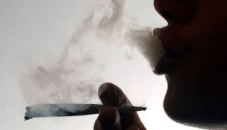
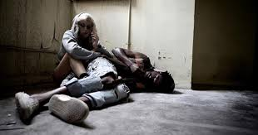

PREOCCUPIED USER
-thinking more about drugs
-want to be “high” often
-blackouts occur
-relationships get difficult
-clearly wants to use the drug
--uses alone, VERY dangerous
--still think they have control

Slide 5
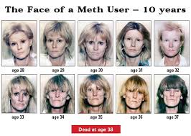

DEPENDENCY
-can no longer get “high”
-must take drug to survive
-no choice, must use
-relates to drugs, not people
-will use anytime
-obnoxious, intimidating
-drugs are your life!

